Slide 1
Autonomous traffic system
Team Hoffenheim

Slide 2
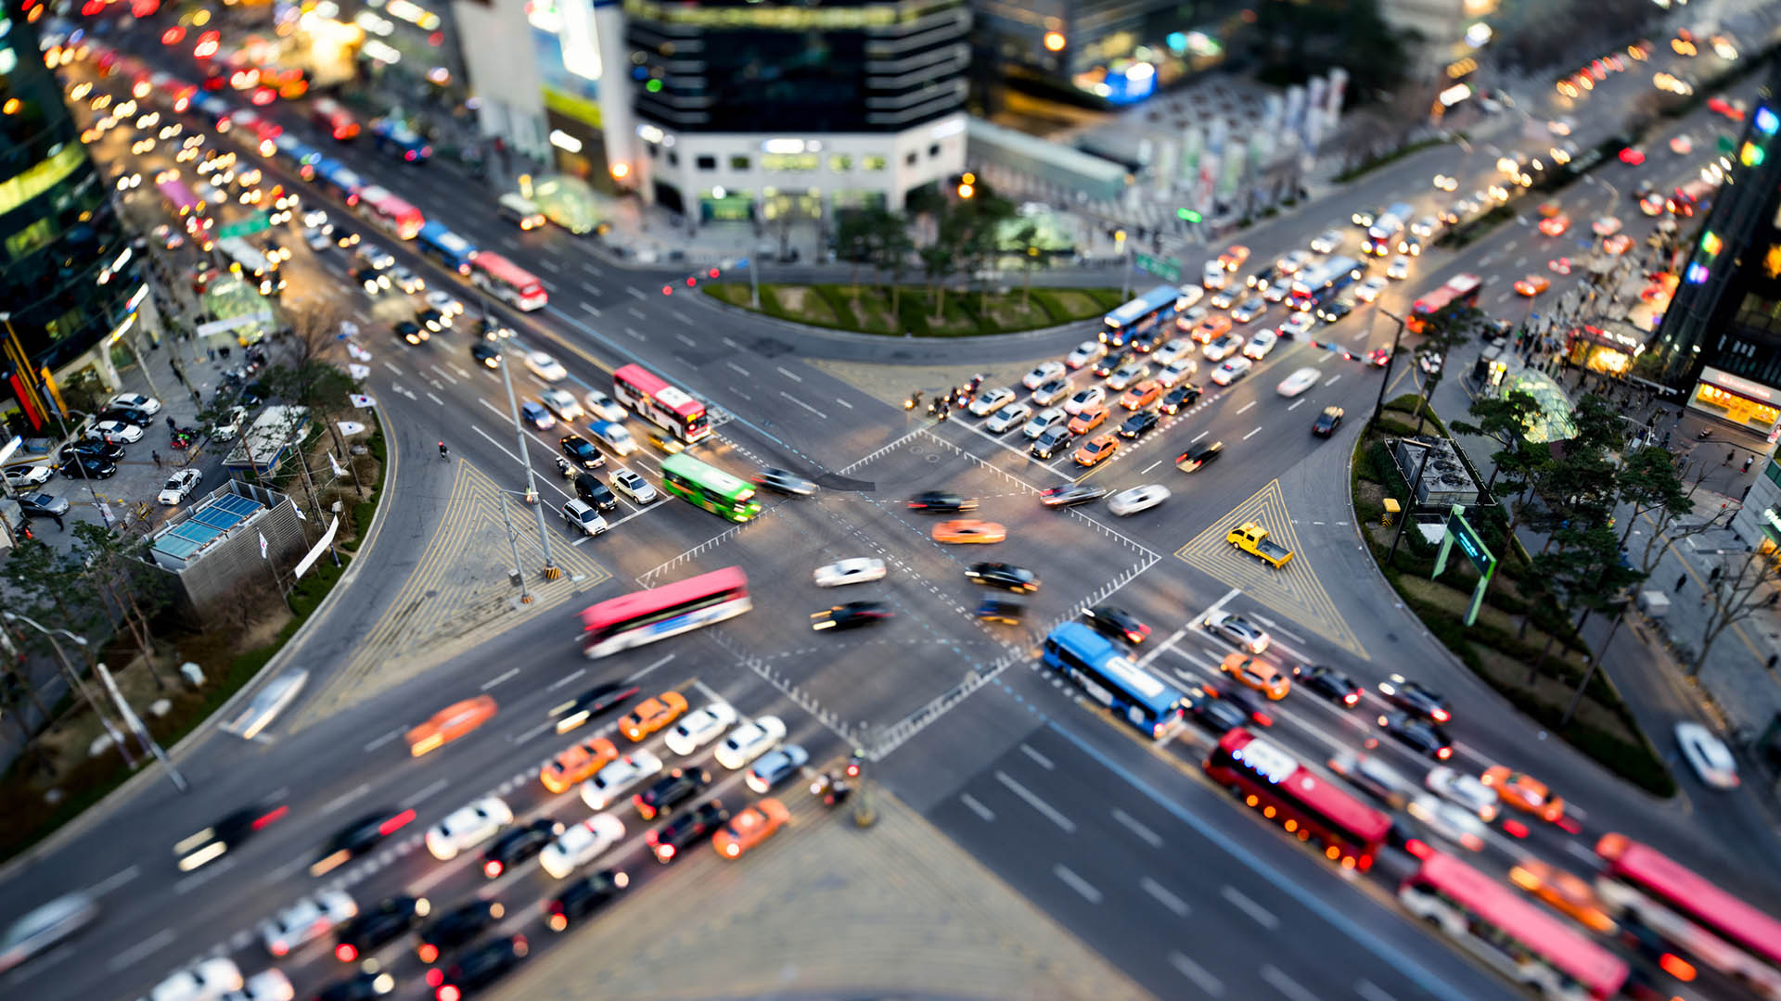
Why ?

Slide 3
How ?

Slide 4



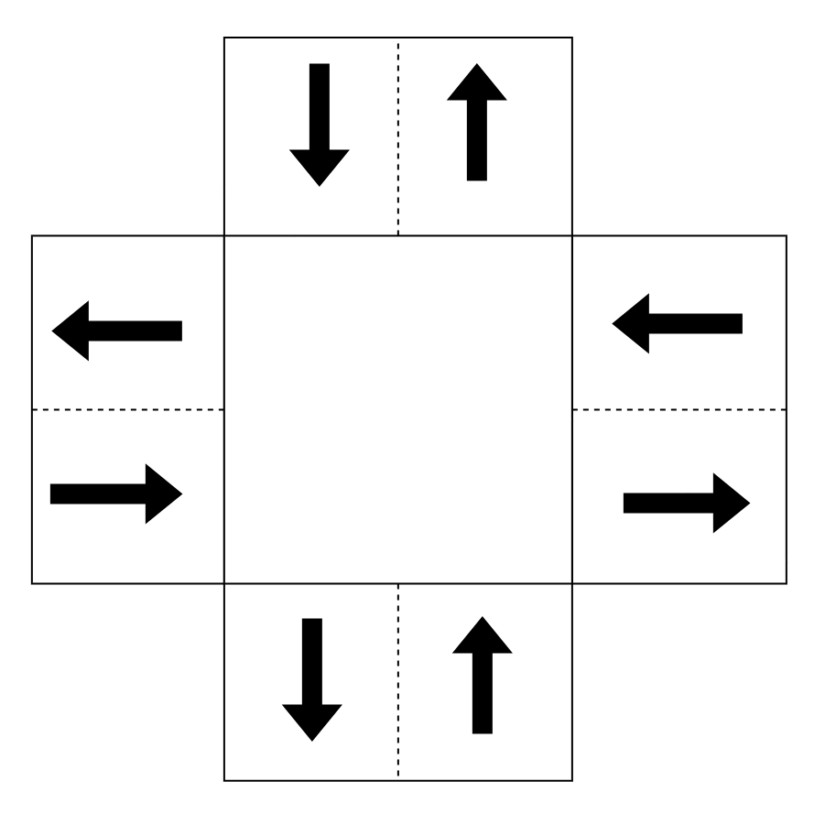
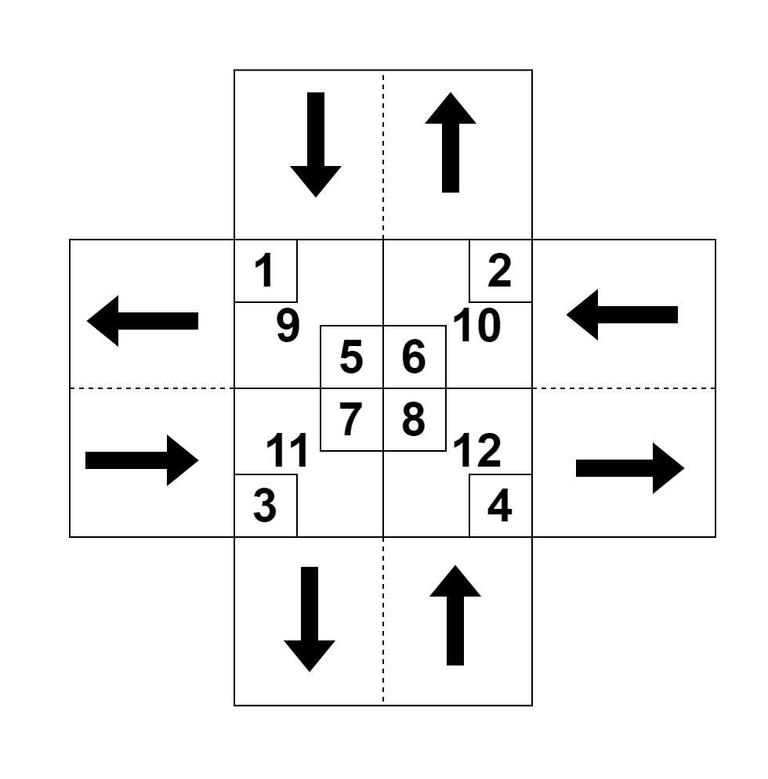

1
2
3
Autonomous traffic controller
Autonomous traffic controller

Slide 5
Approach

Slide 6
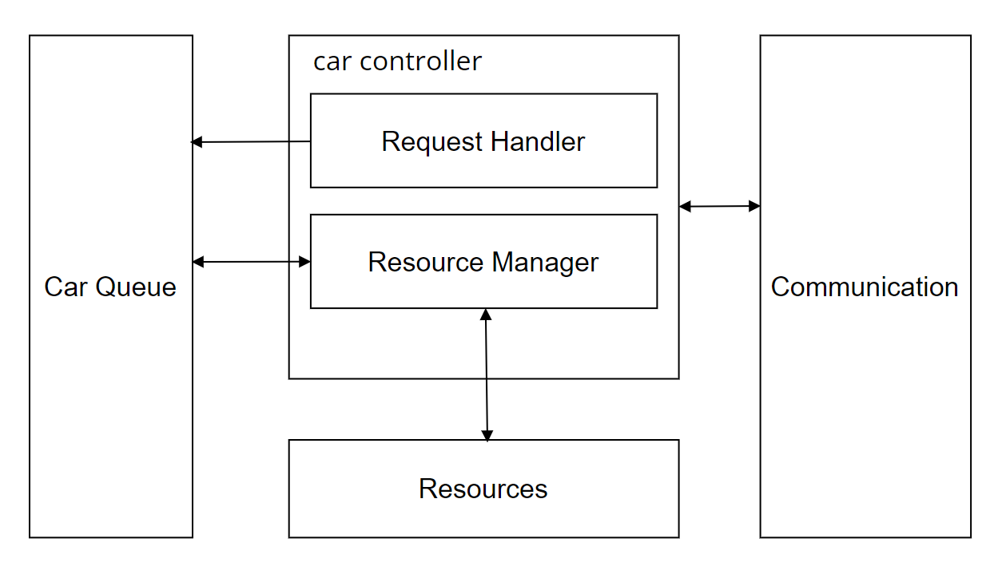
Architecture model

Slide 7
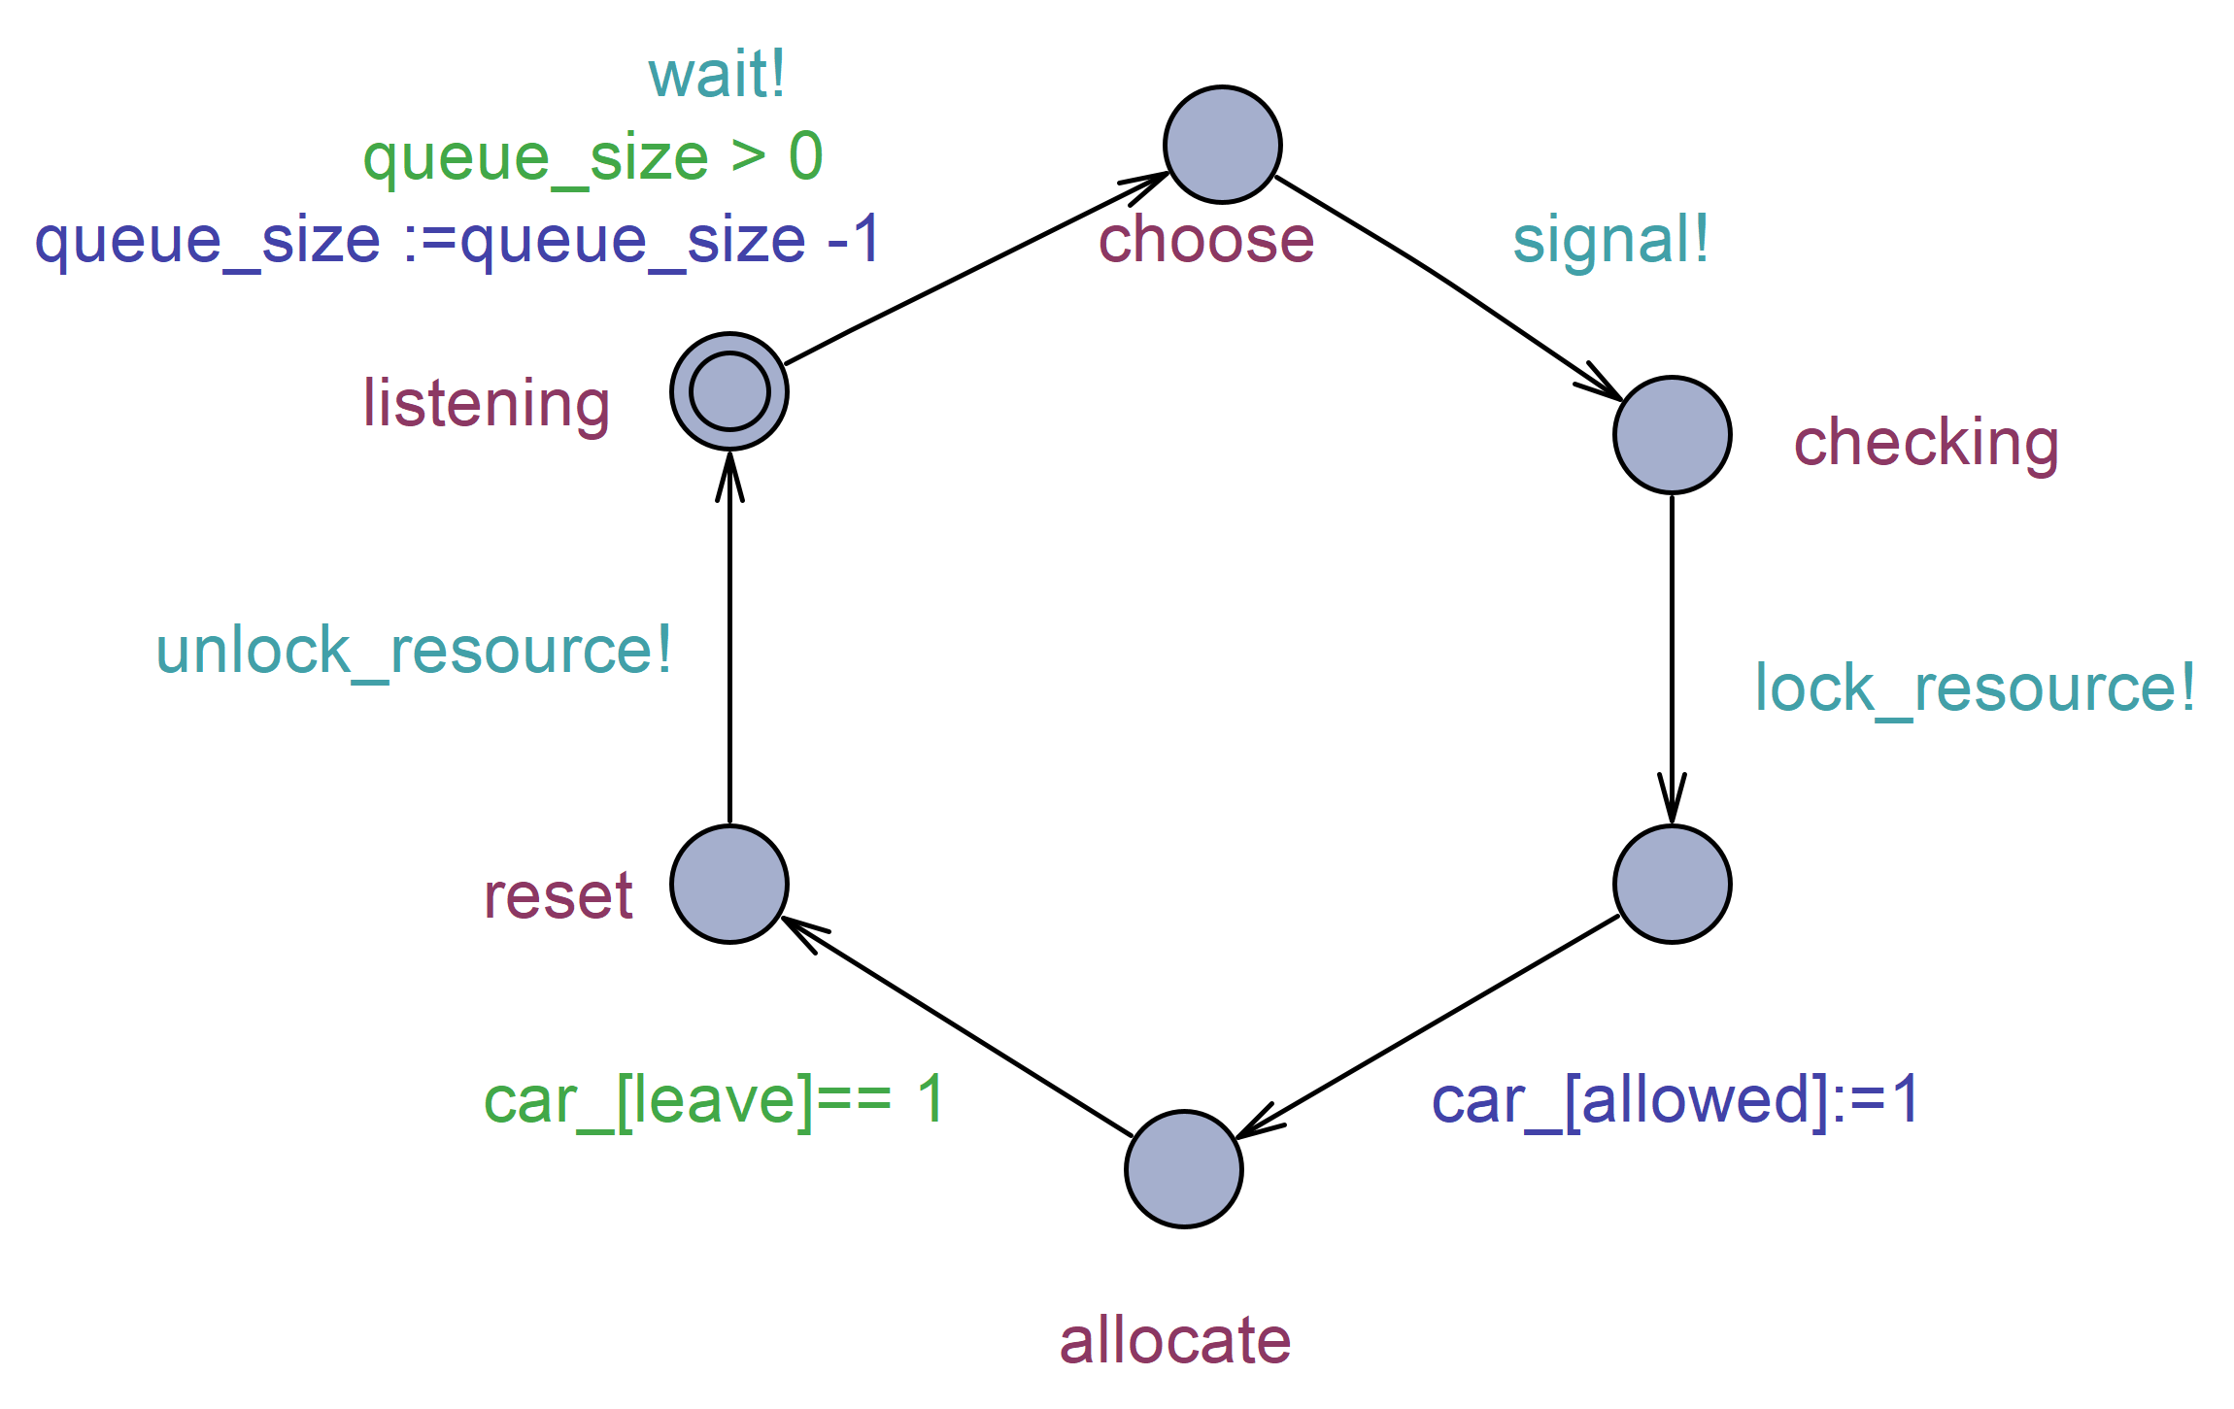
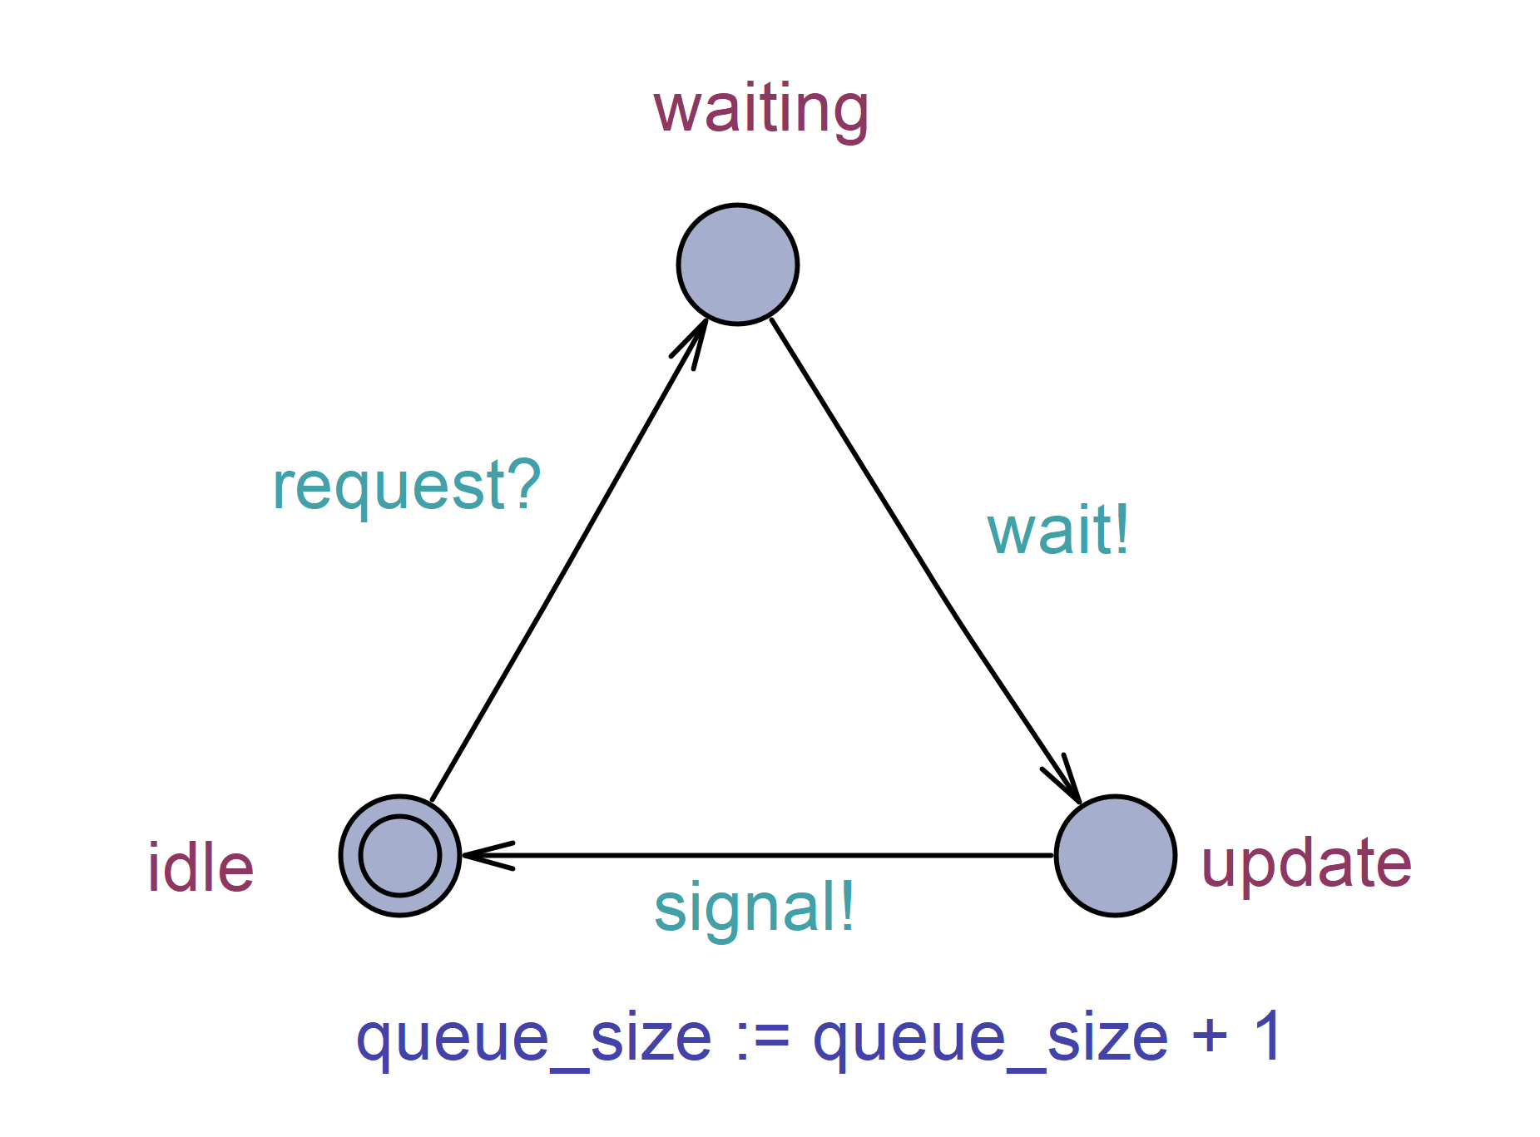
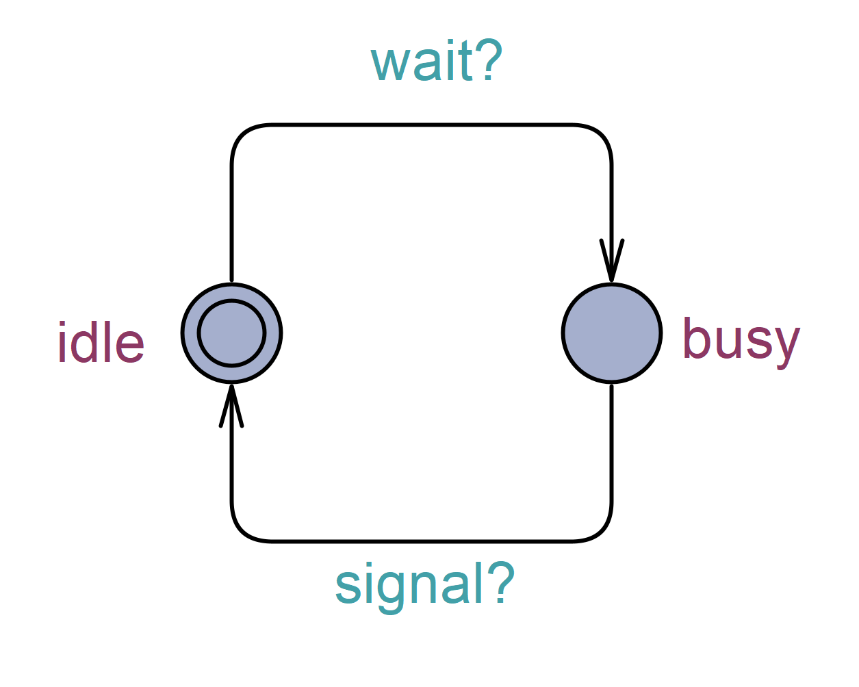
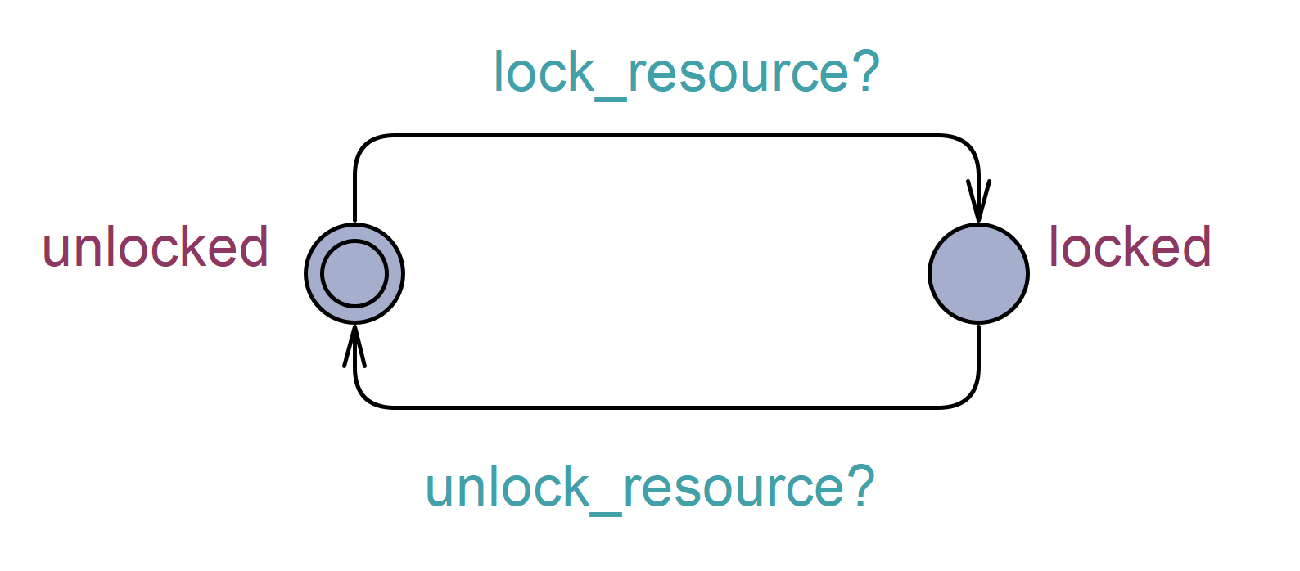
Behavioral model State Chart
Request Handler
Resource Mananger
Resource
Queue

Slide 8
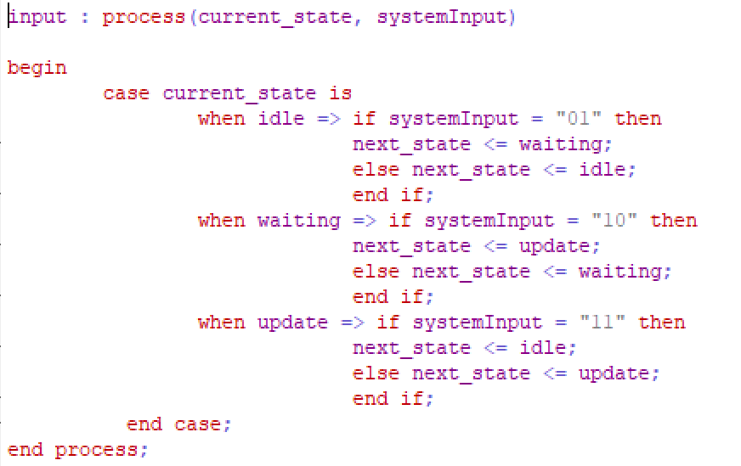
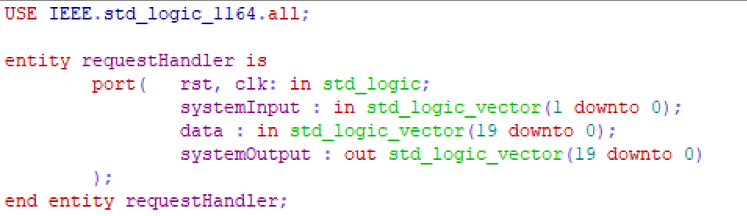
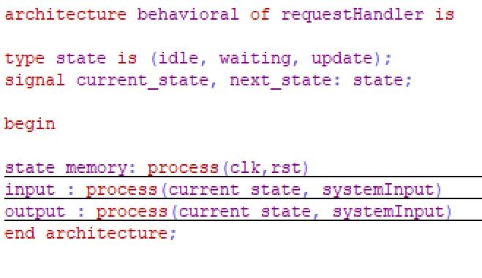
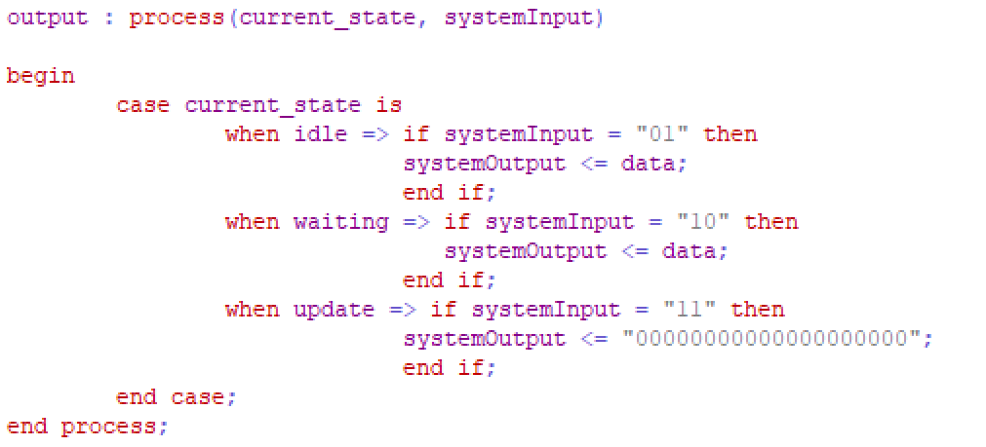
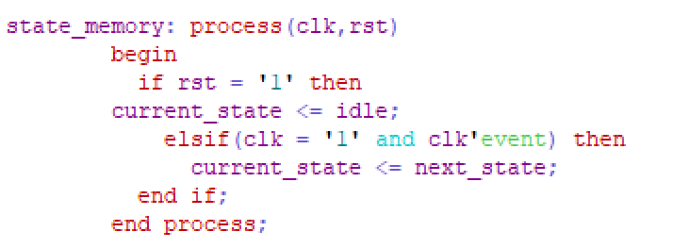
Behavioral model VHDL

Slide 9
The Prototype

Slide 10
FreeRTOS on Arduino
Process
Memory
Request Handler
Resource Mananger
Resource Mananger
Resource Mananger
Queue
Resource

